Slide 2
B
b
B
ds
a

Slide 3


ds
B

Slide 4
Top View

Slide 5
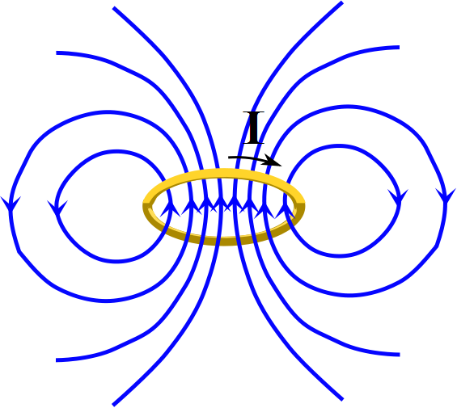

Slide 6
2
1
3
4

Slide 7
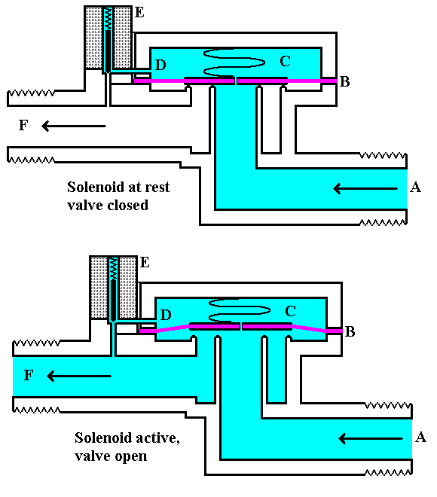

Slide 8
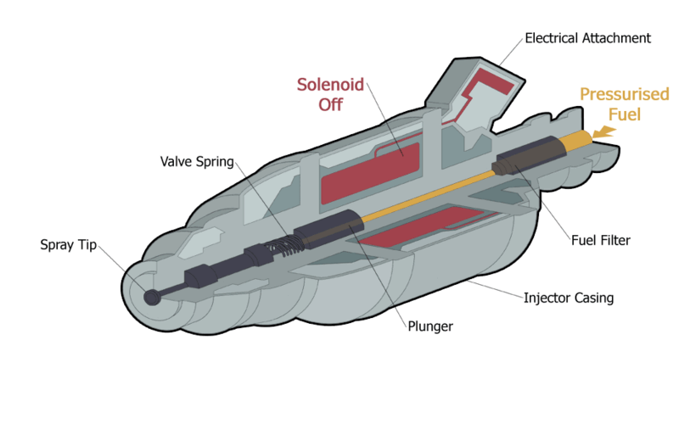
Fuel Injector notional design
WikipedianProlific at en.wikipedia
CC SSA 3.0

Slide 9
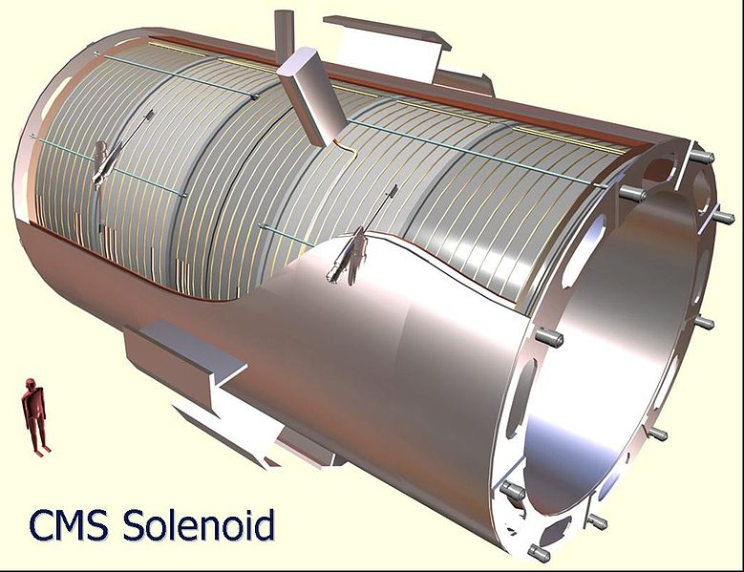

Slide 10
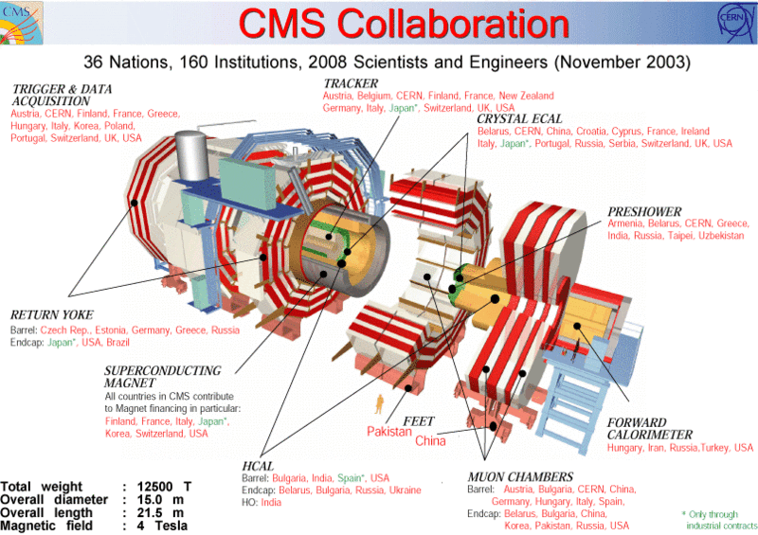

Slide 11
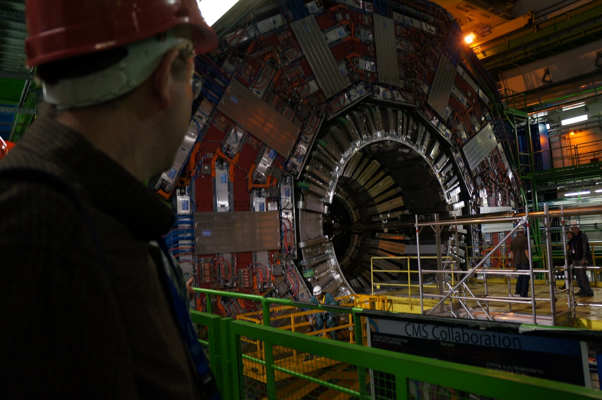

Slide 12
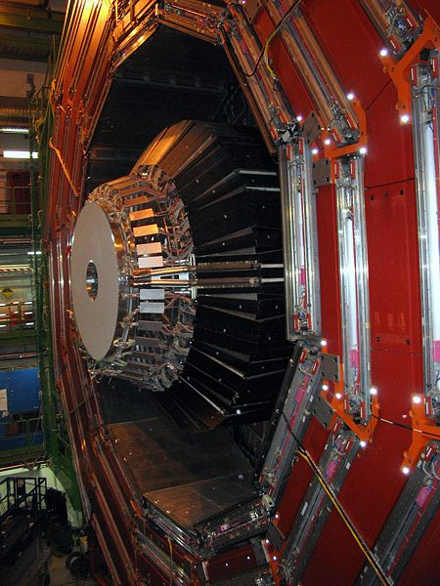

Slide 13
Angle θ
F
B
θ
v

Slide 14
Charge in B-field Setup
v
F
+

Slide 15
Charge in B-field
+
v
F
v
F
+

Slide 16
+

Slide 17
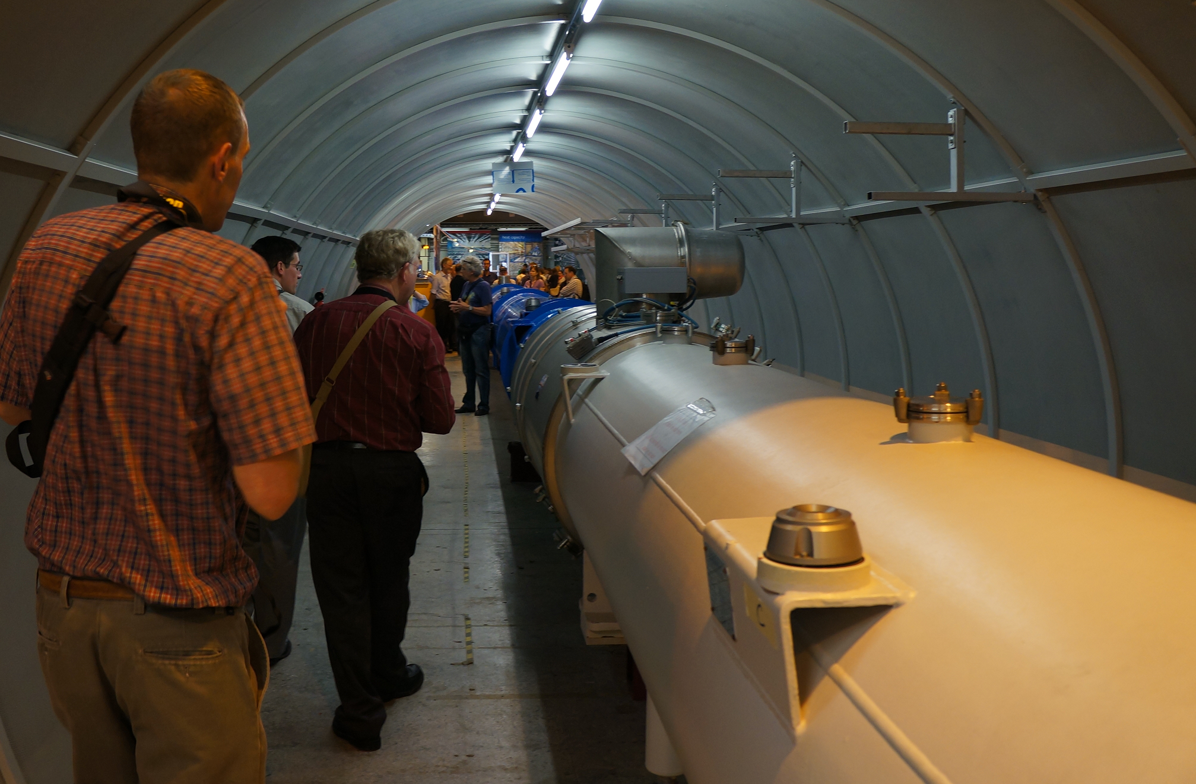

Slide 18
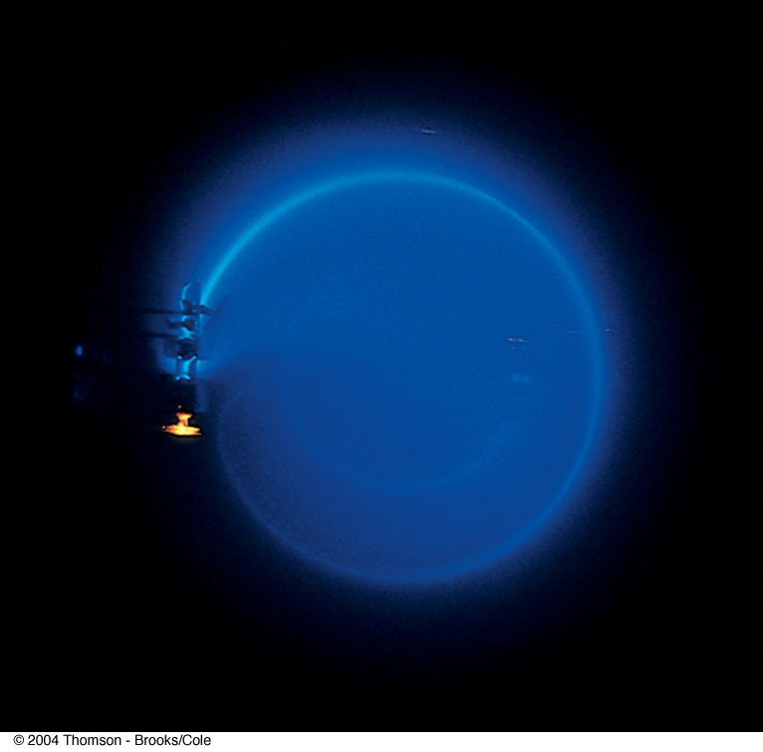
Bending of an Electron Beam

Slide 19
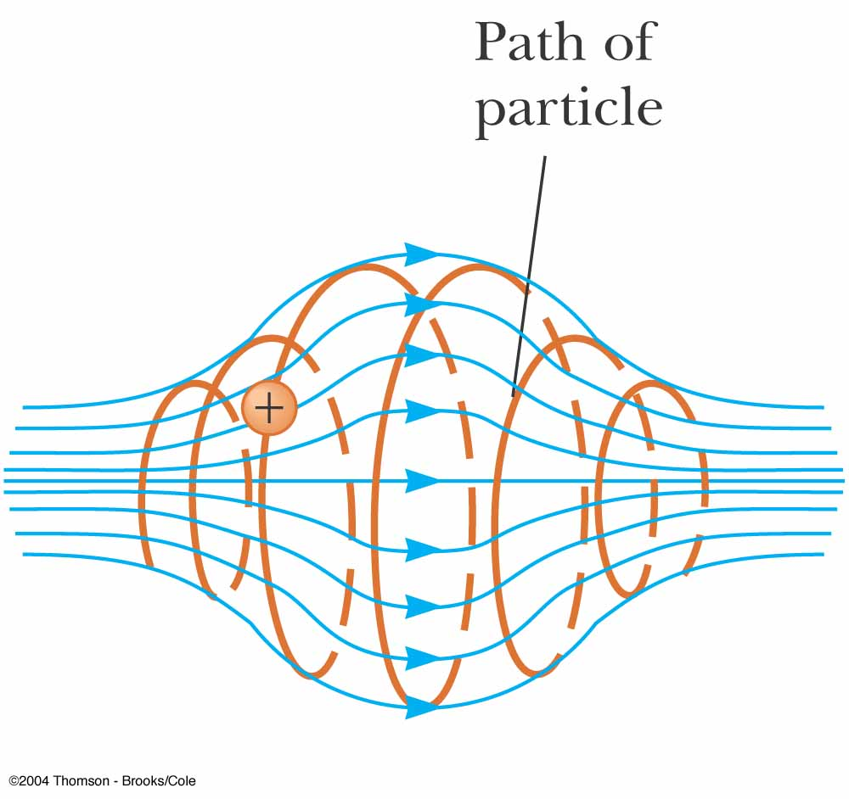

Slide 20
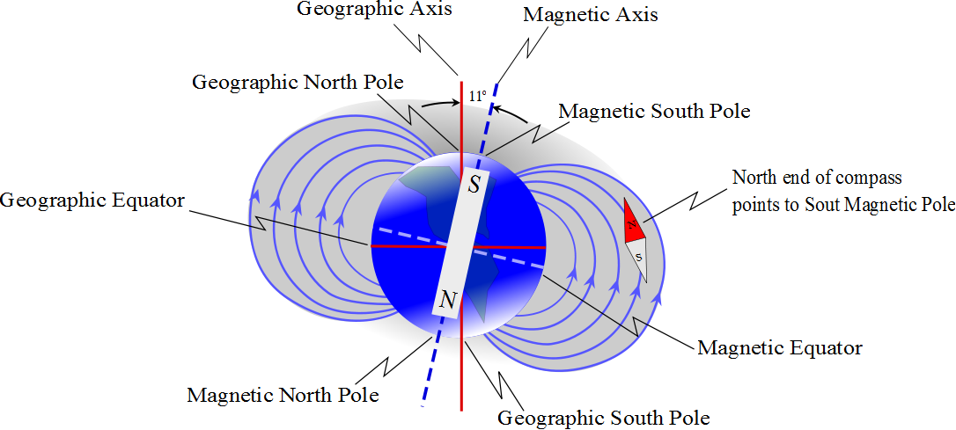
+

Slide 21


Slide 22
B
Source
v
+
E
Slit

Slide 23
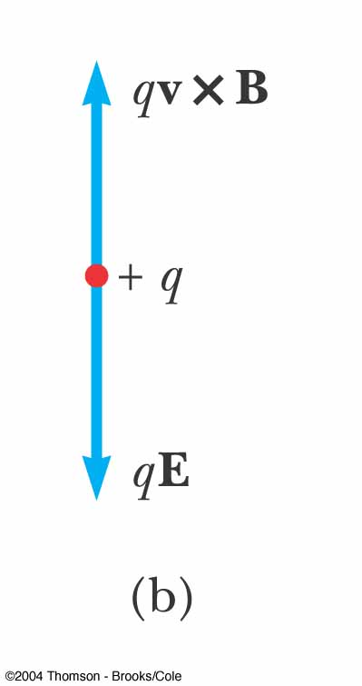
Velocity Selector, cont.
When the force due to the electric field is equal but opposite to the force due to the magnetic field, the particle moves in a straight line
This occurs for velocities of value
v = E / B

Slide 24
Velocity Selector, final
Only those particles with the given speed will pass through the two fields undeflected
The magnetic force exerted on particles moving at speed greater than this is stronger than the electric field and the particles will be deflected upward
Those moving more slowly will be deflected downward

Slide 25
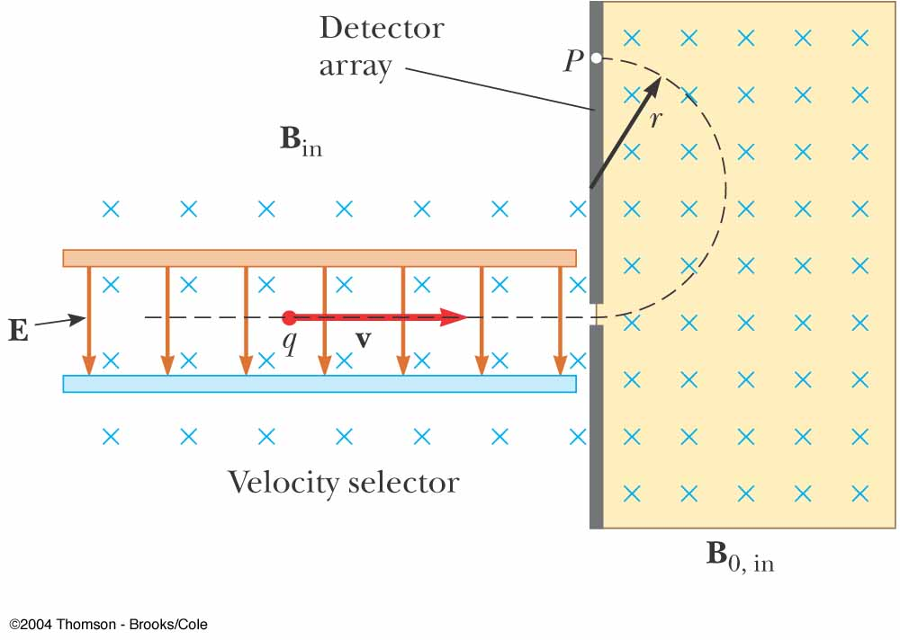
Mass Spectrometer
A mass spectrometer separates ions according to their mass-to-charge ratio
A beam of ions passes through a velocity selector and enters a second magnetic field

Slide 26
Detector
r
B
Source
v
+
E
Slit

Slide 27
Mass Spectrometer, cont.
After entering the second magnetic field, the ions move in a semicircle of radius r before striking a detector at P
If the ions are positively charged, they deflect upward
If the ions are negatively charged, they deflect downward

Slide 28
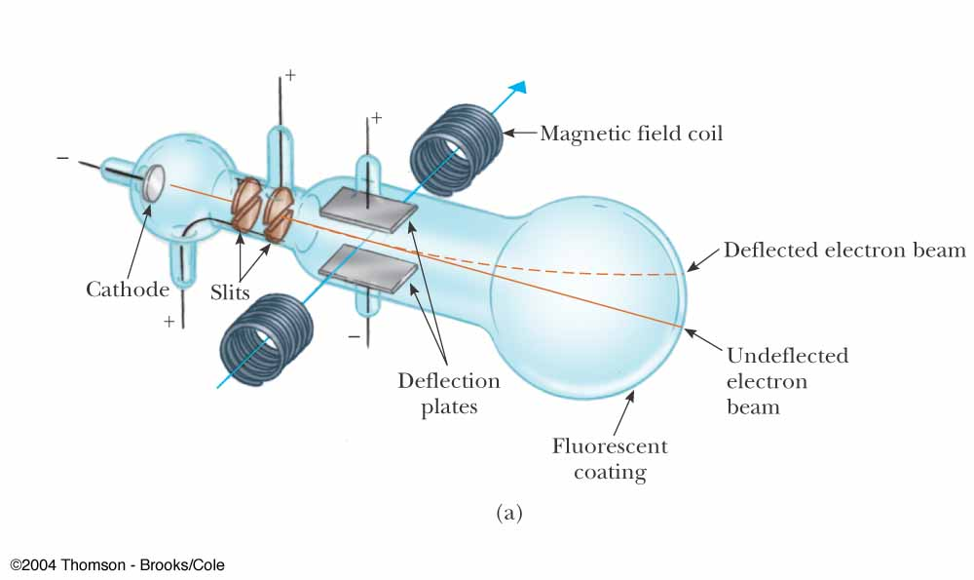
Thomson’s e/m Experiment
Electrons are accelerated from the cathode
They are deflected by electric and magnetic fields
The beam of electrons strikes a fluorescent screen

Slide 29
Thomson’s e/m Experiment, 2
In general, m/q can be determined by measuring the radius of curvature and knowing the magnitudes of the fields
Thomson’s variation found e/m_{e} by measuring the deflection of the beam and the fields

Slide 30
Cyclotron
A cyclotron is a device that can accelerate charged particles to very high speeds
The energetic particles produced are used to bombard atomic nuclei and thereby produce reactions
These reactions can be analyzed by researchers

Slide 31
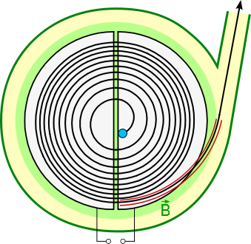
Cyclotron, 2
D₁ and D₂ are called dees because of their shape
A high frequency alternating potential is applied to the dees
A uniform magnetic field is perpendicular to them

Slide 32
Cyclotron, 3
A positive ion is released near the center and moves in a semicircular path
The potential difference is adjusted so that the polarity of the dees is reversed in the same time interval as the particle travels around one dee
This ensures the kinetic energy of the particle increases each trip

Slide 33
Cyclotron, final
The cyclotron’s operation is based on the fact that T is independent of the speed of the particles and of the radius of their path
When the energy of the ions in a cyclotron exceeds about 20 MeV, relativistic effects come into play

Slide 34
Hall Effect
When a current carrying conductor is placed in a magnetic field, a potential difference is generated in a direction perpendicular to both the current and the magnetic field
This phenomena is known as the Hall effect
It arises from the deflection of charge carriers to one side of the conductor as a result of the magnetic forces they experience

Slide 35
Hall Effect, cont.
The Hall effect gives information regarding the sign of the charge carriers and their density
It can also be used to measure magnetic fields

Slide 36
Hall Voltage
c
a
I

Slide 37
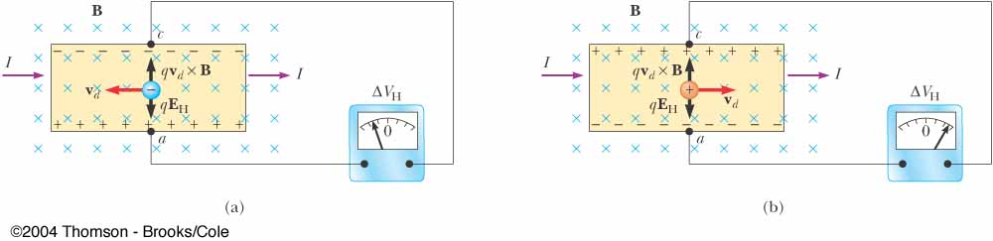
Hall Voltage, cont
When the charge carriers are negative, the upper edge of the conductor becomes negatively charged
When the charge carriers are positive, the upper edge becomes positively charged

Slide 38
Hall Voltage, final
ΔV_{H} = E_{H}d = v_{d} B d
d is the width of the conductor
v_{d} is the drift velocity
If B and d are known, v_{d} can be found
R_{H} = 1 / nq is called the Hall coefficient
A properly calibrated conductor can be used to measure the magnitude of an unknown magnetic field

